Slide 1
PetFinder.my
Adoption Speed Prediction

Slide 2
The goal
Given data on pets put up for adoption on PetFinder.my, predict how quickly a pet will be adopted.

Slide 3
Variables
Breed | Age | Color | Name | Description
Photos | Videos | Maturity Size | Vaccinated | Fee
Health | State | Fur Length | Gender | Quantity

Slide 4
Target - Adoption Speed
0 - Adopted on the same day as listed
1 - Adopted between 1 and 7 days
2 - Adopted between 8 and 30 days
3 - Adopted between 31 and 90 days
4 - No adoption after 100 days

Slide 5
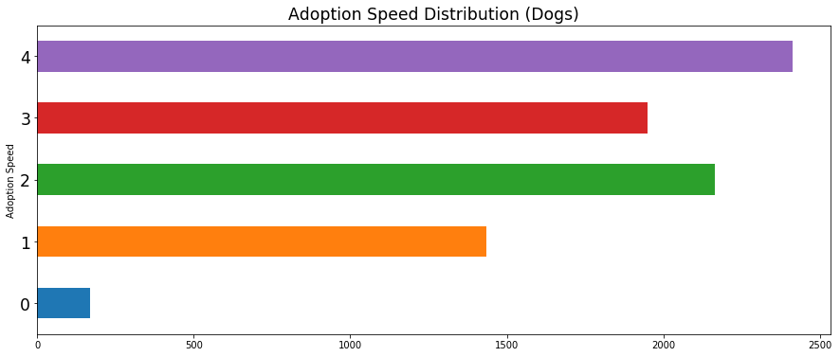
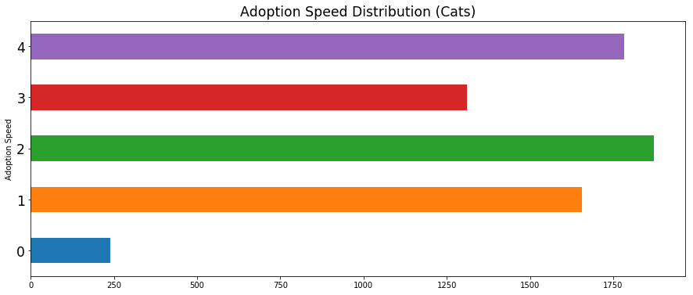
Adoption Speed
Distribution

Slide 6
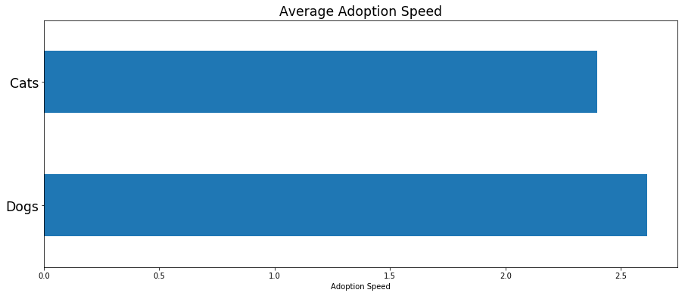

Slide 7
Training
Method | Baseline Score* | Tuned Score*
Random Forest | 0.293 | 0.358
XGBoost | 0.369 | 0.383
Adaboost | 0.330 | 0.347
Notes:
* Calculated using Cohen kappa quadratic score on a validation set of size 0.25.

Slide 8
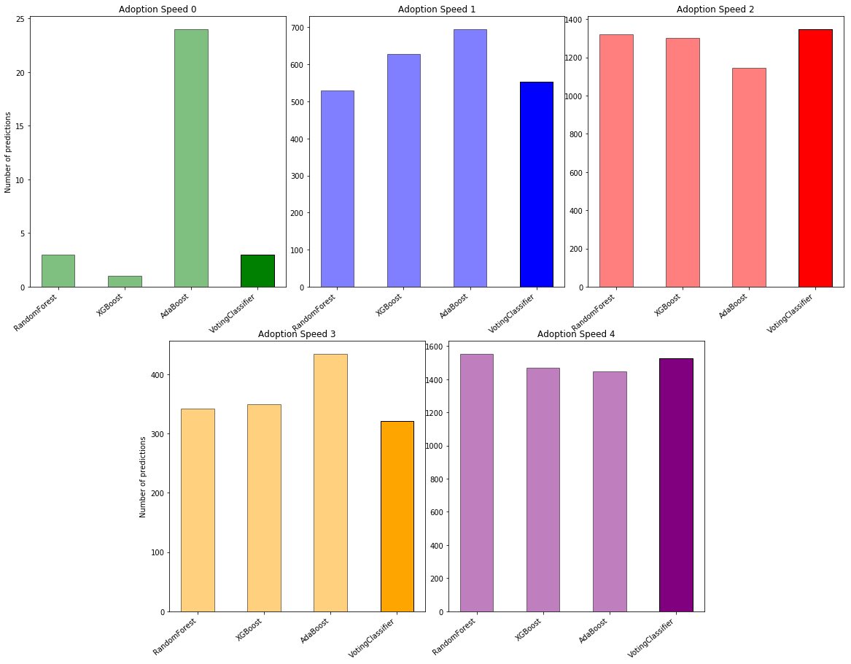
Ensemble
Method | Score
Voting Classifier* | 0.386
Notes:
VotingClassifier from sklearn using ‘soft’ voting.

Slide 9
Final model performance*
Score | 0.333
Notes:
* On test data set aside

Slide 10
Future improvements
Improve predictions of Adoption Speed 0
Testing inclusion/exclusion of certain variables
Deeper exploration of photos and descriptions

